Slide 1


How to Multiply
integers, matrices, and polynomials
Slides by Kevin Wayne.
Copyright © 2005 Pearson-Addison Wesley.
All rights reserved.

Slide 2
Complex Multiplication
Complex multiplication. (a + bi) (c + di) = x + yi.
Grade-school. x = ac - bd, y = bc + ad.
Q. Is it possible to do with fewer multiplications?
4 multiplications, 2 additions

Slide 3
Complex Multiplication
Complex multiplication. (a + bi) (c + di) = x + yi.
Grade-school. x = ac - bd, y = bc + ad.
Q. Is it possible to do with fewer multiplications?
A. Yes. [Gauss] x = ac - bd, y = (a + b) (c + d) - ac - bd.
Remark. Improvement if no hardware multiply.
4 multiplications, 2 additions
3 multiplications, 5 additions

Slide 4
5.5 Integer Multiplication

Slide 5
Integer Addition
Addition. Given two n-bit integers a and b, compute a + b.
Grade-school. Θ(n) bit operations.
Remark. Grade-school addition algorithm is optimal.
1
1
1
1
1
1
0
1
1
1
0
1
0
1
0
1
+
0
1
1
1
1
1
0
1
1
0
1
0
1
0
0
1
0

Slide 6
Integer Multiplication
Multiplication. Given two n-bit integers a and b, compute a × b.
Grade-school. Θ(n²) bit operations.
Q. Is grade-school multiplication algorithm optimal?
1
1
0
1
0
1
0
1
×
0
1
1
1
1
1
0
1
1
1
0
1
0
1
0
1
0
0
0
0
0
0
0
0
0
1
1
0
1
0
1
0
1
0
1
1
0
1
0
1
0
1
0
1
1
0
1
0
1
0
1
0
1
1
0
1
0
1
0
1
0
1
1
0
1
0
1
0
1
0
0
0
0
0
0
0
0
0
0
0
1
1
0
1
0
0
0
0
0
0
0
0
0
0
1

Slide 7
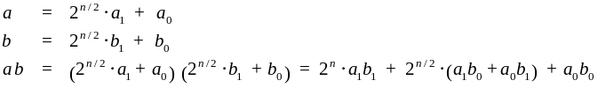

Divide-and-Conquer Multiplication: Warmup
To multiply two n-bit integers a and b:
  Multiply four ½n-bit integers, recursively.
  Add and shift to obtain result.
Ex.
a = 10001101 b = 11100001
a₁
a₀
b₁
b₀
Notes:
assumes n is a power of 2

Slide 8


Recursion Tree
T(n)
n
T(n/2)
T(n/2)
T(n/2)
T(n/2)
4(n/2)
T(n/4)
T(n/4)
T(n/4)
T(n/4)
...
T(n/4)
T(n/4)
T(n/4)
T(n/4)
16(n/4)
...
...
T(n / 2^{k})
4^{k} (n / 2^{k})
...
...
T(2)
T(2)
T(2)
T(2)
...
T(2)
T(2)
T(2)
T(2)
4 ^{lg n} (1)

Slide 9
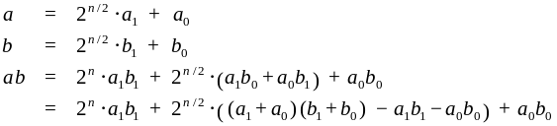
Karatsuba Multiplication
To multiply two n-bit integers a and b:
  Add two ½n bit integers.
  Multiply three ½n-bit integers, recursively.
  Add, subtract, and shift to obtain result.
1
2
1
3
3
Notes:
Karatsuba: also works for multiplying two degree N univariate polynomials

Slide 10
Karatsuba Multiplication
To multiply two n-bit integers a and b:
  Add two ½n bit integers.
  Multiply three ½n-bit integers, recursively.
  Add, subtract, and shift to obtain result.
Theorem. [Karatsuba-Ofman 1962] Can multiply two n-bit integers
in O(n^{1.585}) bit operations.
1
2
1
3
3
Notes:
Karatsuba: also works for multiplying two degree N univariate polynomials

Slide 11


Karatsuba: Recursion Tree
T(n)
n
T(n/2)
T(n/2)
T(n/2)
3(n/2)
T(n/4)
T(n/4)
T(n/4)
T(n/4)
T(n/4)
T(n/4)
T(n/4)
T(n/4)
T(n/4)
9(n/4)
...
...
T(n / 2^{k})
3^{k} (n / 2^{k})
...
...
T(2)
T(2)
T(2)
T(2)
...
T(2)
T(2)
T(2)
T(2)
3 ^{lg n} (1)

Slide 12
Fast Integer Division Too (!)
Integer division. Given two n-bit (or less) integers s and t,
compute quotient q = s / t and remainder r = s mod t.
Fact. Complexity of integer division is same as integer multiplication.
To compute quotient q:
  Approximate x = 1 / t using Newton's method:
  After log n iterations, either q = ⎣s x⎦ or q = ⎡s x⎤.
using fast
multiplication

Slide 13
Matrix Multiplication

Slide 14


Dot Product
Dot product. Given two length n vectors a and b, compute c = a ⋅ b.
Grade-school. Θ(n) arithmetic operations.
Remark. Grade-school dot product algorithm is optimal.
Notes:
among most basic problems in linear algebra and scientific computing

Slide 15

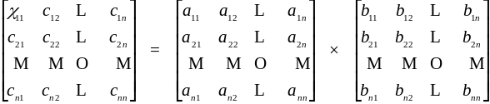

Matrix Multiplication
Matrix multiplication. Given two n-by-n matrices A and B, compute C = AB.
Grade-school. Θ(n³) arithmetic operations.
Q. Is grade-school matrix multiplication algorithm optimal?
Notes:
among most basic problems in linear algebra and scientific computing

Slide 16
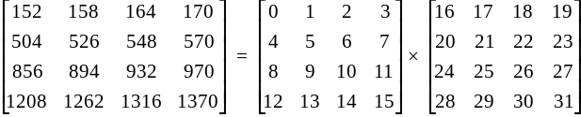
Block Matrix Multiplication
C₁₁
A₁₁
A₁₂
B₁₁
B₁₁

Slide 17

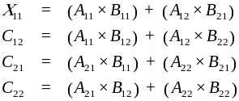

Matrix Multiplication: Warmup
To multiply two n-by-n matrices A and B:
  Divide: partition A and B into ½n-by-½n blocks.
  Conquer: multiply 8 pairs of ½n-by-½n matrices, recursively.
  Combine: add appropriate products using 4 matrix additions.
Notes:
for scalars, probably not worth elimination one multiplication at expense of 14 extra additions (cost of add and multiply similar), but for matrices can make huge difference since standard multiplies are more expensive than additions

Slide 18

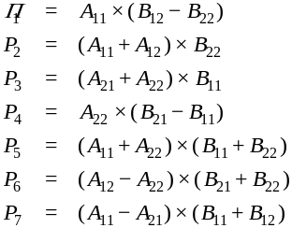
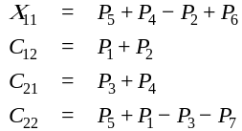
Fast Matrix Multiplication
Key idea. multiply 2-by-2 blocks with only 7 multiplications.
  7 multiplications.
  18 = 8 + 10 additions and subtractions.
Notes:
somewhat counterintuitive to be subtracting, especially if all original matrix entries are positive
Winograd's variant. 7 multiplications, 15 additions, but less numerically stable than Strassen

Slide 19

Fast Matrix Multiplication
To multiply two n-by-n matrices A and B: [Strassen 1969]
  Divide: partition A and B into ½n-by-½n blocks.
  Compute: 14 ½n-by-½n matrices via 10 matrix additions.
  Conquer: multiply 7 pairs of ½n-by-½n matrices, recursively.
  Combine: 7 products into 4 terms using 8 matrix additions.
Analysis.
  Assume n is a power of 2.
  T(n) = # arithmetic operations.

Slide 20
Fast Matrix Multiplication: Practice
Implementation issues.
  Sparsity.
  Caching effects.
  Numerical stability.
  Odd matrix dimensions.
  Crossover to classical algorithm around n = 128.
Common misperception. “Strassen is only a theoretical curiosity.”
  Apple reports 8x speedup on G4 Velocity Engine when n ≈ 2,500.
  Range of instances where it's useful is a subject of controversy.
Remark. Can "Strassenize" Ax = b, determinant, eigenvalues, SVD, ….
Notes:
Parallelization can also be an issue.
can be made stable

Slide 21
Fast Matrix Multiplication: Theory
Q. Multiply two 2-by-2 matrices with 7 scalar multiplications?
A. Yes! [Strassen 1969]
Q. Multiply two 2-by-2 matrices with 6 scalar multiplications?
A. Impossible. [Hopcroft and Kerr 1971]
Q. Two 3-by-3 matrices with 21 scalar multiplications?
A. Also impossible.
Begun, the decimal wars have. [Pan, Bini et al, Schönhage, …]
■ Two 20-by-20 matrices with 4,460 scalar multiplications.
■ Two 48-by-48 matrices with 47,217 scalar multiplications.
■ A year later.
■ December, 1979.
■ January, 1980.
Notes:
Hopcroft-Kerr bound applies to non-commutative case
"Imagine excitement in January, 1980 when this was improved to"

Slide 22
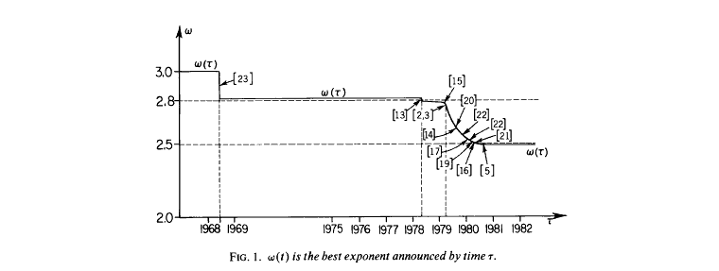
Fast Matrix Multiplication: Theory
Best known. O(n^{2.376}) [Coppersmith-Winograd, 1987]
Conjecture. O(n^{2+ε}) for any ε > 0.
Caveat. Theoretical improvements to Strassen are progressively
less practical.

Slide 23
5.6 Convolution and FFT

Slide 24
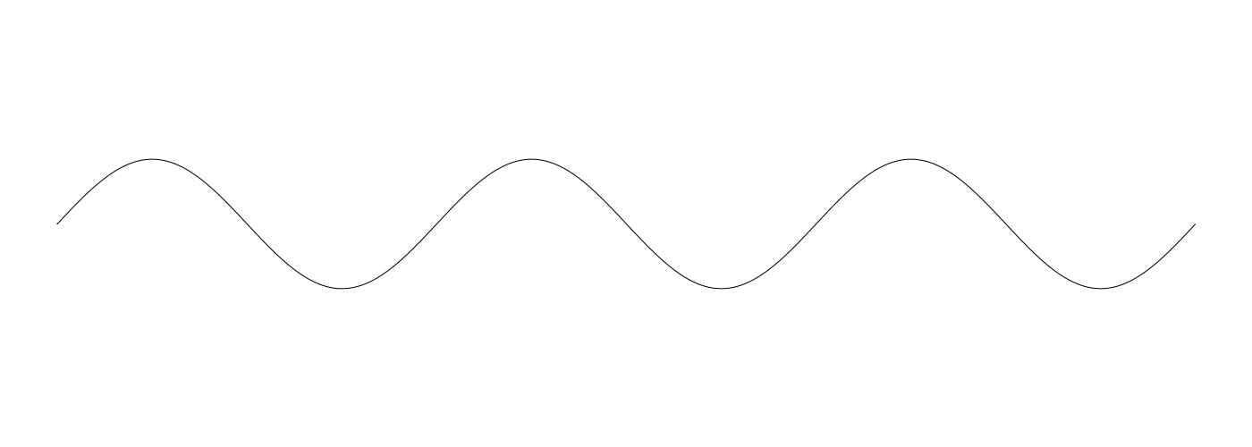
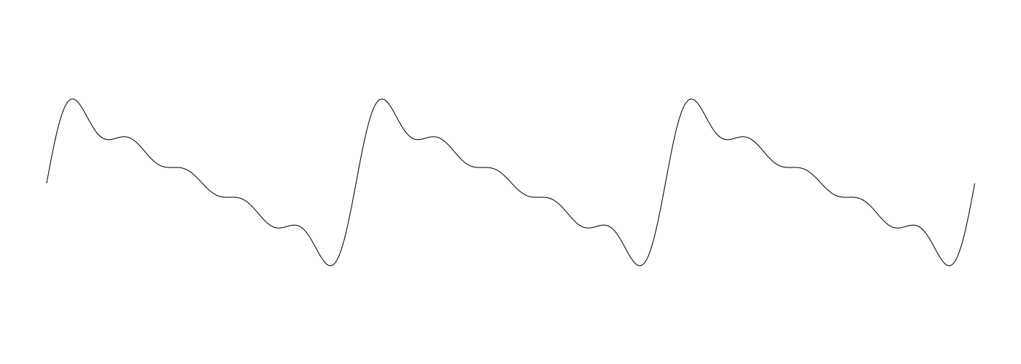
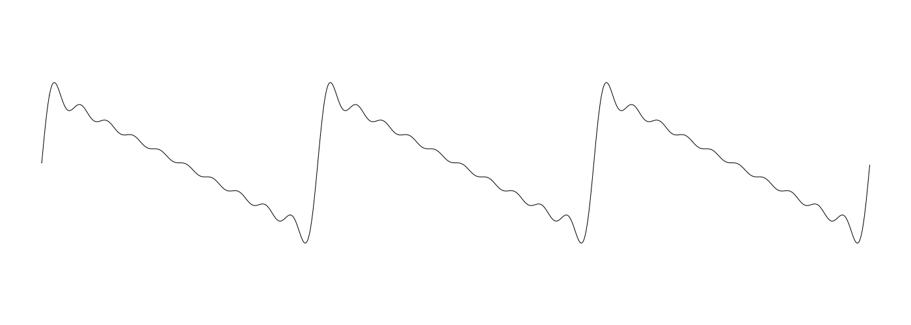
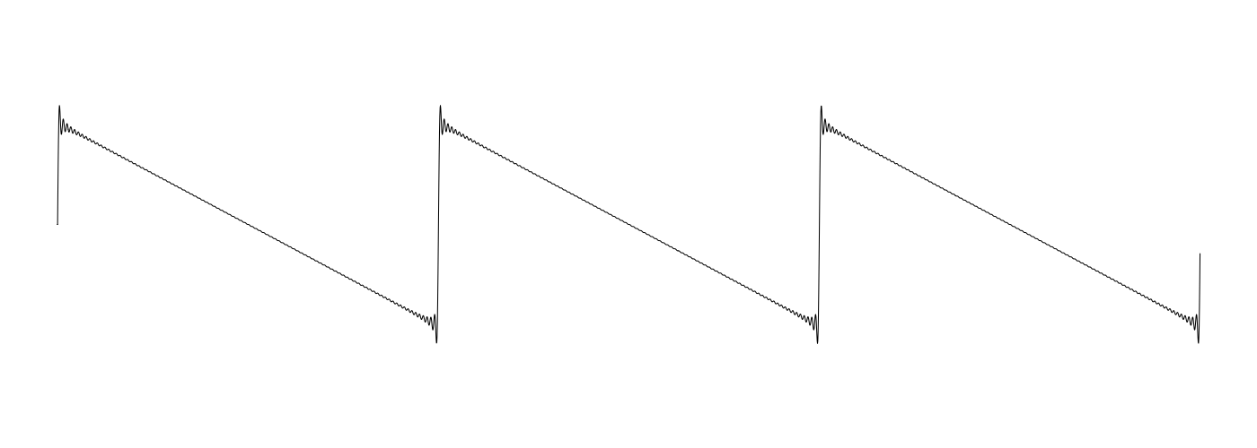
Fourier Analysis
Fourier theorem. [Fourier, Dirichlet, Riemann] Any periodic function can be expressed as the sum of a series of sinusoids.
sufficiently smooth
t
N = 1
N = 5
N = 10
N = 100
Notes:
Fourier was the first to recognize that such trigonometric series could represent arbitrary functions, even those with discontinuities.
Later, Dirichlet and Riemann expressed Fourier's results with greater precision and formality.
sawtooth wave

Slide 25
Euler's Identity
Sinusoids. Sum of sine an cosines.
Sinusoids. Sum of complex exponentials.
e^{ix} = cos x + i sin x
Euler's identity

Slide 26

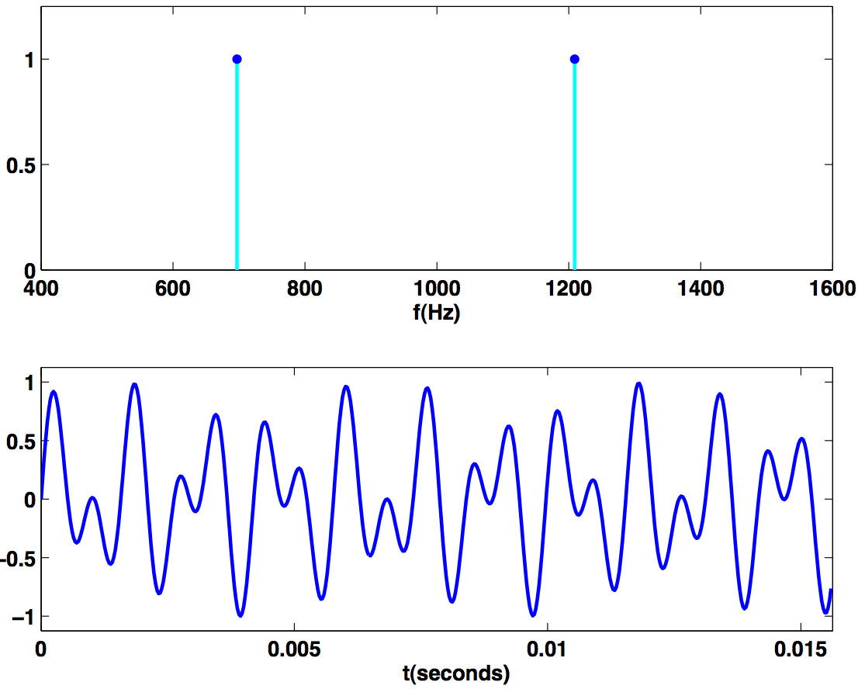
Time Domain vs. Frequency Domain
Signal. [touch tone button 1]
Time domain.
Frequency domain.
sound
pressure
time (seconds)
0.5
amplitude
frequency (Hz)
Reference: Cleve Moler, Numerical Computing with MATLAB
Notes:
We assume it's continuous (or many many samples)
Most noise in nature (e.g., wind blowing, ocean surf) have no distinct frequency signature.
What carries information are sudden changes in volume and frequency (e.g., bee buzzing, branch breaking)
Human ear recognizes such frequency signatures

Slide 27
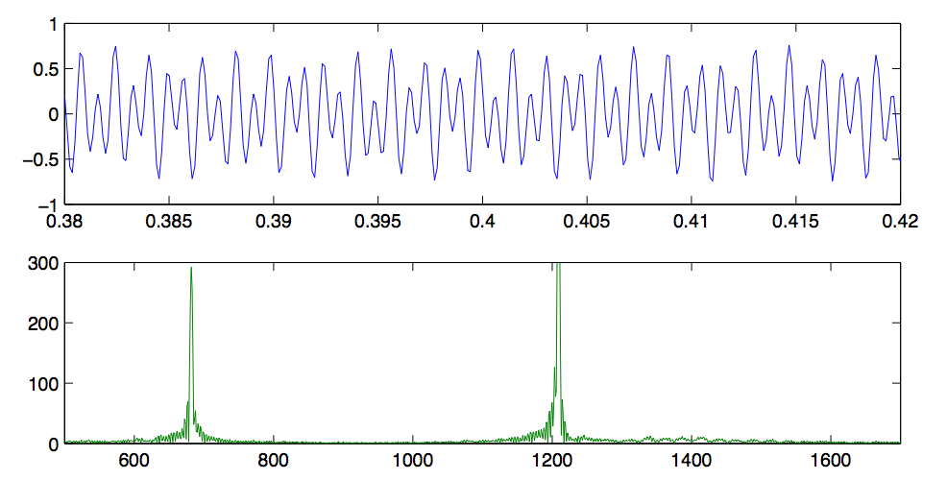
Time Domain vs. Frequency Domain
Signal. [recording, 8192 samples per second]
Magnitude of discrete Fourier transform.
Reference: Cleve Moler, Numerical Computing with MATLAB
Notes:
fft is complex number - we plot the magnitude
application of frequency domain: can filter frequencies polluting the signal

Slide 28
Fast Fourier Transform
FFT. Fast way to convert between time-domain and frequency-domain.
Alternate viewpoint. Fast way to multiply and evaluate polynomials.
we take this approach
If you speed up any nontrivial algorithm by a factor of a million or so the world will beat a path towards finding useful applications for it. -Numerical Recipes

Slide 29
Fast Fourier Transform: Applications
Applications.
  Optics, acoustics, quantum physics, telecommunications, radar, control systems, signal processing, speech recognition, data compression, image processing, seismology, mass spectrometry…
  Digital media. [DVD, JPEG, MP3, H.264]
  Medical diagnostics. [MRI, CT, PET scans, ultrasound]
  Numerical solutions to Poisson's equation.
  Shor's quantum factoring algorithm.
  …
The FFT is one of the truly great computational developments of [the 20th] century. It has changed the face of science and engineering so much that it is not an exaggeration to say that life as we know it would be very different without the FFT. -Charles van Loan
Notes:
Significance. Perhaps single algorithmic discovery that has had the greatest practical impact in history. Progress in these areas limited by lack of fast algorithms.
Difficult to overstate importance of FFT (!)
Variants of FFT used for JPEG, e.g., fast sine/cosine transforms

Slide 30
Fast Fourier Transform: Brief History
Gauss (1805, 1866). Analyzed periodic motion of asteroid Ceres.
Runge-König (1924). Laid theoretical groundwork.
Danielson-Lanczos (1942). Efficient algorithm, x-ray crystallography.
Cooley-Tukey (1965). Monitoring nuclear tests in Soviet Union and tracking submarines. Rediscovered and popularized FFT.
Importance not fully realized until advent of digital computers.
Notes:
Gauss' algorithm published posthumously in 1866
Tukey was Princeton professor.
cautionary tale: Cooley published paper after IBM lawyers decided against setting a precedent for patenting numerical algorithms.
The prevailing wisdom was that nobody could make money selling software; the money was in selling hardware.
IBM lawyers figured anyone using FFT would need to buy expensive supercomputers and their hardware!
Times have certainly changed!

Slide 31
Polynomials: Coefficient Representation
Polynomial. [coefficient representation]
Add. O(n) arithmetic operations.
Evaluate. O(n) using Horner's method.
Multiply (convolve). O(n²) using brute force.
Notes:
can also multiply in O(n^1.585) using Karatsuba polynomial multiplication

Slide 32
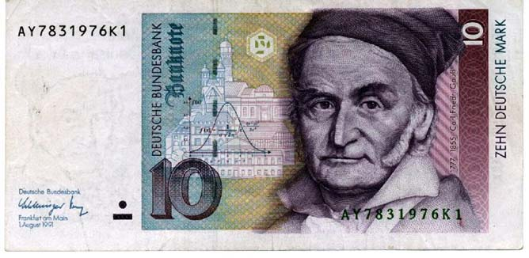
A Modest PhD Dissertation Title
"New Proof of the Theorem That Every Algebraic Rational Integral Function In One Variable can be Resolved into Real Factors of the First or the Second Degree."
- PhD dissertation, 1799 the University of Helmstedt
Notes:
In his dissertation Gauss severly criticized Legendre, Laplace and other major mathematicians of the day for their lack of rigour.

Slide 33
Polynomials: Point-Value Representation
Fundamental theorem of algebra. [Gauss, PhD thesis] A degree n polynomial with complex coefficients has exactly n complex roots.
Corollary. A degree n-1 polynomial A(x) is uniquely specified by its evaluation at n distinct values of x.
y
y_{j} = A(x_{j} )
x_{j}
x
Notes:
deep theorem - proof requires analysis
conjectures in 17th century, but not rigorously proved until Gauss' phd thesis
established imaginary numbers as fundamental mathematical objects

Slide 34
Polynomials: Point-Value Representation
Polynomial. [point-value representation]
Add. O(n) arithmetic operations.
Multiply (convolve). O(n), but need 2n-1 points.
Evaluate. O(n²) using Lagrange's formula.
Notes:
Lagrange's formula is numerically unstable

Slide 35
Converting Between Two Polynomial Representations
Tradeoff. Fast evaluation or fast multiplication. We want both!
Goal. Efficient conversion between two representations ⇒ all ops fast.
representation
multiply
evaluate
coefficient
O(n²)
O(n)
point-value
O(n)
O(n²)
coefficient representation
point-value representation

Slide 36
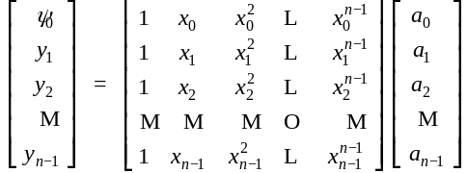
Converting Between Two Representations: Brute Force
Coefficient ⇒ point-value. Given a polynomial a₀ + a₁ x + ... + a_{n-1} x^{n-1}, evaluate it at n distinct points x₀ , ..., x_{n-1}.
Running time. O(n²) for matrix-vector multiply (or n Horner's).

Slide 37
Converting Between Two Representations: Brute Force
Point-value ⇒ coefficient. Given n distinct points x₀, ... , x_{n-1} and values y₀, ... , y_{n-1}, find unique polynomial a₀ + a₁x + ... + a_{n-1} x^{n-1}, that has given values at given points.
Running time. O(n³) for Gaussian elimination.
Vandermonde matrix is invertible iff x_{i} distinct
or O(n^{2.376}) via fast matrix multiplication

Slide 38
Divide-and-Conquer
Decimation in frequency. Break up polynomial into low and high powers.
  A(x) = a₀ + a₁x + a₂x² + a₃x³ + a₄x⁴ + a₅x⁵ + a₆x⁶ + a₇x⁷.
  A_{low}(x) = a₀ + a₁x + a₂x² + a₃x³.
  A_{high} (x) = a₄ + a₅x + a₆x² + a₇x³.
  A(x) = A_{low}(x) + x⁴ A_{high}(x).
Decimation in time. Break polynomial up into even and odd powers.
  A(x) = a₀ + a₁x + a₂x² + a₃x³ + a₄x⁴ + a₅x⁵ + a₆x⁶ + a₇x⁷.
  A_{even}(x) = a₀ + a₂x + a₄x² + a₆x³.
  A_{odd} (x) = a₁ + a₃x + a₅x² + a₇x³.
  A(x) = A_{even}(x²) + x A_{odd}(x²).

Slide 39
Coefficient to Point-Value Representation: Intuition
Coefficient ⇒ point-value. Given a polynomial a₀ + a₁x + ... + a_{n-1} x^{n-1}, evaluate it at n distinct points x₀ , ..., x_{n-1}.
Divide. Break polynomial up into even and odd powers.
  A(x) = a₀ + a₁x + a₂x² + a₃x³ + a₄x⁴ + a₅x⁵ + a₆x⁶ + a₇x⁷.
  A_{even}(x) = a₀ + a₂x + a₄x² + a₆x³.
  A_{odd} (x) = a₁ + a₃x + a₅x² + a₇x³.
  A(x) = A_{even}(x²) + x A_{odd}(x²).
  A(-x) = A_{even}(x²) - x A_{odd}(x²).
Intuition. Choose two points to be ±1.
  A( 1) = A_{even}(1) + 1 A_{odd}(1).
  A(-1) = A_{even}(1) - 1 A_{odd}(1).
we get to choose which ones!
Can evaluate polynomial of degree ≤ n
at 2 points by evaluating two polynomials of degree ≤ ½n at 1 point.

Slide 40
Coefficient to Point-Value Representation: Intuition
Coefficient ⇒ point-value. Given a polynomial a₀ + a₁x + ... + a_{n-1} x^{n-1}, evaluate it at n distinct points x₀ , ..., x_{n-1}.
Divide. Break polynomial up into even and odd powers.
  A(x) = a₀ + a₁x + a₂x² + a₃x³ + a₄x⁴ + a₅x⁵ + a₆x⁶ + a₇x⁷.
  A_{even}(x) = a₀ + a₂x + a₄x² + a₆x³.
  A_{odd} (x) = a₁ + a₃x + a₅x² + a₇x³.
  A(x) = A_{even}(x²) + x A_{odd}(x²).
  A(-x) = A_{even}(x²) - x A_{odd}(x²).
Intuition. Choose four complex points to be ±1, ±i.
  A(1) = A_{even}(1) + 1 A_{odd}(1).
  A(-1) = A_{even}(1) - 1 A_{odd}(1).
  A( i ) = A_{even}(-1) + i A_{odd}(-1).
  A( -i ) = A_{even}(-1) - i A_{odd}(-1).
we get to choose which ones!
Can evaluate polynomial of degree ≤ n
at 4 points by evaluating two polynomials of degree ≤ ½n at 2 points.

Slide 41
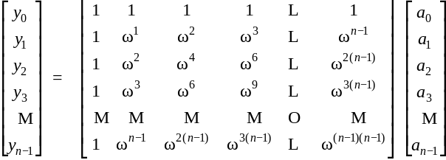
Discrete Fourier Transform
Coefficient ⇒ point-value. Given a polynomial a₀ + a₁x + ... + a_{n-1} x^{n-1}, evaluate it at n distinct points x₀ , ..., x_{n-1}.
Key idea. Choose x_{k} = ω^{k} where ω is principal n^{th} root of unity.
DFT
Fourier matrix F_{n}

Slide 42
Roots of Unity
Def. An n^{th} root of unity is a complex number x such that x^{n} = 1.
Fact. The n^{th} roots of unity are: ω⁰, ω¹, …, ω^{n-1} where ω = e ^{2π i / n}.
Pf. (ω^{k})^{n} = (e ^{2π i k / n}) ^{n} = (e ^{π i} ) ^{2k} = (-1) ^{2k} = 1.
Fact. The ½n^{th} roots of unity are: ν⁰, ν¹, …, ν^{n/2-1} where ν = ω² = e ^{4π i / n}.
ω² = ν¹ = i
ω³
ω¹
ω⁴ = ν² = -1
n = 8
ω⁰ = ν⁰ = 1
ω⁵
ω⁷
ω⁶ = ν³ = -i
Notes:
forms a group under multiplication (similar to additive group Z_n modulo n)

Slide 43
Fast Fourier Transform
Goal. Evaluate a degree n-1 polynomial A(x) = a₀ + ... + a_{n-1} x^{n-1} at its
n^{th} roots of unity: ω⁰, ω¹, …, ω^{n-1}.
Divide. Break up polynomial into even and odd powers.
  A_{even}(x) = a₀ + a₂x + a₄x² + … + a_{n-2} x ^{n/2 - 1}.
  A_{odd} (x) = a₁ + a₃x + a₅x² + … + a_{n-1} x ^{n/2 - 1}.
  A(x) = A_{even}(x²) + x A_{odd}(x²).
Conquer. Evaluate A_{even}(x) and A_{odd}(x) at the ½n^{th}
roots of unity: ν⁰, ν¹, …, ν^{n/2-1}.
Combine.
  A(ω ^{k}) = A_{even}(ν ^{k}) + ω ^{k} A_{odd} (ν ^{k}), 0 ≤ k < n/2
  A(ω ^{k+ ½n}) = A_{even}(ν ^{k}) – ω ^{k} A_{odd} (ν ^{k}), 0 ≤ k < n/2
ν^{k} = (ω^{k} )²
ν^{k} = (ω^{k + ½n} )²
ω^{k+ ½n} = -ω^{k}

Slide 44
FFT Algorithm
fft(n, a₀,a₁,…,a_{n-1}) {
if (n == 1) return a₀
(e₀,e₁,…,e_{n/2-1}) ← FFT(n/2, a₀,a₂,a₄,…,a_{n-2})
(d₀,d₁,…,d_{n/2-1}) ← FFT(n/2, a₁,a₃,a₅,…,a_{n-1})
for k = 0 to n/2 - 1 {
ω^{k} ← e^{2πik/n}
y_{k+n/2} ← e_{k} + ω^{k} d_{k}
y_{k+n/2} ← e_{k} - ω^{k} d_{k}
}
return (y₀,y₁,…,y_{n-1})
}

Slide 45
FFT Summary
Theorem. FFT algorithm evaluates a degree n-1 polynomial at each of the n^{th} roots of unity in O(n log n) steps.
Running time.
assumes n is a power of 2
O(n log n)
coefficient
representation
???
point-value
representation

Slide 46
Recursion Tree
a₀, a₁, a₂, a₃, a₄, a₅, a₆, a₇
perfect shuffle
a₀, a₂, a₄, a₆
a₁, a₃, a₅, a₇
a₀, a₄
a₂, a₆
a₁, a₅
a₃, a₇
a₀
a₄
a₂
a₆
a₁
a₅
a₃
a₇
000
100
010
110
001
101
011
111
"bit-reversed" order
Notes:
each recursive call performs a "perfect shuffle"
leaves of tree are in "bit-reversed" order - if you read the bits backwards, it counts from 000 to 111 in binary

Slide 47
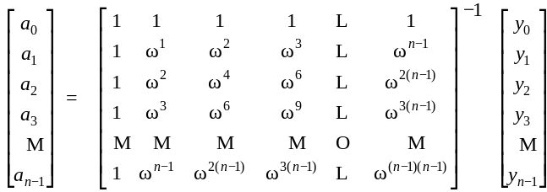
Inverse Discrete Fourier Transform
Point-value ⇒ coefficient. Given n distinct points x₀, ... , x_{n-1} and values y₀, ... , y_{n-1}, find unique polynomial a₀ + a₁x + ... + a_{n-1} x^{n-1}, that has given values at given points.
Inverse DFT
Fourier matrix inverse (F_{n}) ⁻¹

Slide 48
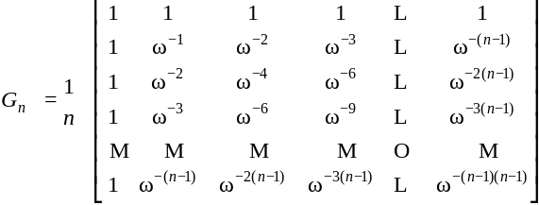

Inverse DFT
Claim. Inverse of Fourier matrix F_{n} is given by following formula.
Consequence. To compute inverse FFT, apply same algorithm but use
ω⁻¹ = e ^{-2π i / n} as principal n^{th} root of unity (and divide by n).

Slide 49


Inverse FFT: Proof of Correctness
Claim. F_{n} and G_{n} are inverses.
Pf.
Summation lemma. Let ω be a principal n^{th} root of unity. Then
Pf.
  If k is a multiple of n then ω^{k} = 1 ⇒ series sums to n.
  Each n^{th} root of unity ω^{k} is a root of x^{n} - 1 = (x - 1) (1 + x + x² + ... + x^{n-1}).
  if ω^{k} ≠ 1 we have: 1 + ω^{k} + ω^{k(2)} + … + ω^{k(n-1)} = 0 ⇒ series sums to 0. ▪
summation lemma

Slide 50
Inverse FFT: Algorithm
ifft(n, a₀,a₁,…,a_{n-1}) {
if (n == 1) return a₀
(e₀,e₁,…,e_{n/2-1}) ← FFT(n/2, a₀,a₂,a₄,…,a_{n-2})
(d₀,d₁,…,d_{n/2-1}) ← FFT(n/2, a₁,a₃,a₅,…,a_{n-1})
for k = 0 to n/2 - 1 {
ω^{k} ← e^{-2πik/n}
y_{k+n/2} ← (e_{k} + ω^{k} d_{k}) / n
y_{k+n/2} ← (e_{k} - ω^{k} d_{k}) / n
}
return (y₀,y₁,…,y_{n-1})
}

Slide 51
Inverse FFT Summary
Theorem. Inverse FFT algorithm interpolates a degree n-1 polynomial given values at each of the n^{th} roots of unity in O(n log n) steps.
assumes n is a power of 2
O(n log n)
O(n log n)
point-value
representation
coefficient
representation

Slide 52


Polynomial Multiplication
Theorem. Can multiply two degree n-1 polynomials in O(n log n) steps.
pad with 0s to make n a power of 2
coefficient
representation
coefficient
representation
2 FFTs
O(n log n)
inverse FFT
O(n log n)
point-value multiplication
O(n)

Slide 53
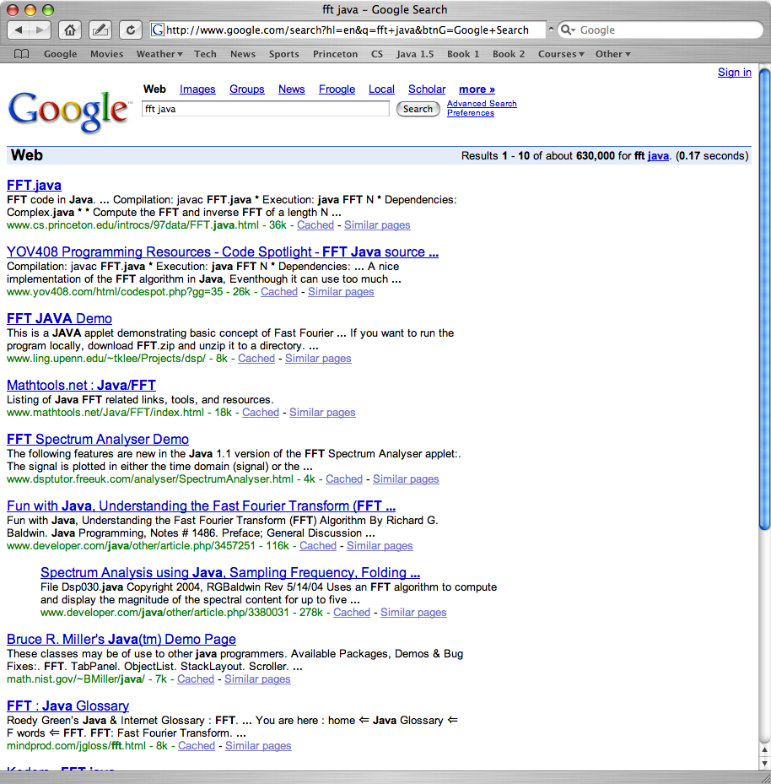
FFT in Practice ?

Slide 54
FFT in Practice
Fastest Fourier transform in the West. [Frigo and Johnson]
  Optimized C library.
  Features: DFT, DCT, real, complex, any size, any dimension.
  Won 1999 Wilkinson Prize for Numerical Software.
  Portable, competitive with vendor-tuned code.
Implementation details.
  Instead of executing predetermined algorithm, it evaluates your hardware and uses a special-purpose compiler to generate an optimized algorithm catered to "shape" of the problem.
  Core algorithm is nonrecursive version of Cooley-Tukey.
  O(n log n), even for prime sizes.
Reference: http://www.fftw.org
Notes:
also handles multidimensional FFTs

Slide 55
Integer Multiplication, Redux
Integer multiplication. Given two n bit integers a = a_{n-1} … a₁a₀ and
b = b_{n-1} … b₁b₀, compute their product a ⋅ b.
Convolution algorithm.
  Form two polynomials.
  Note: a = A(2), b = B(2).
  Compute C(x) = A(x) ⋅ B(x).
  Evaluate C(2) = a ⋅ b.
  Running time: O(n log n) complex arithmetic operations.
Theory. [Schönhage-Strassen 1971] O(n log n log log n) bit operations.
Theory. [Fürer 2007] O(n log n 2^{O(log *n)}) bit operations.

Slide 56
Integer Multiplication, Redux
Integer multiplication. Given two n bit integers a = a_{n-1} … a₁a₀ and
b = b_{n-1} … b₁b₀, compute their product a ⋅ b.
Practice. [GNU Multiple Precision Arithmetic Library]
It uses brute force, Karatsuba, and FFT, depending on the size of n.
"the fastest bignum library on the planet"

Slide 57
Integer Arithmetic
Fundamental open question. What is complexity of arithmetic?
Operation
Upper Bound
Lower Bound
addition
O(n)
Ω(n)
multiplication
O(n log n 2^{O(log*n)})
Ω(n)
division
O(n log n 2^{O(log*n)})
Ω(n)

Slide 58
Factoring
Factoring. Given an n-bit integer, find its prime factorization.
2773 = 47 × 59
2⁶⁷-1 = 147573952589676412927 = 193707721 × 761838257287
a disproof of Mersenne's conjecture that 2⁶⁷ - 1 is prime
740375634795617128280467960974295731425931888892312890849
362326389727650340282662768919964196251178439958943305021
275853701189680982867331732731089309005525051168770632990
72396380786710086096962537934650563796359
RSA-704
($30,000 prize if you can factor)
Notes:
Marin Mersenne conjectured that numbers of the form 2^{p} - 1 are prime for p = 2, 3, 5, 7, 13, 17, 19, 31, 67, 127 and 257. His conjecture for p = 67 was disproved by F. N. Cole over two hundred and fifty years later in 1903. According to E. T. Bell's book Mathematics: Queen and Servant of ScienceIn the October meeting of the AMS, Cole announced a talk "On the Factorisation of Large Numbers". He walked up to the blackboard without saying a word, calculated by hand the value of 2⁶⁷, carefully subtracted 1. Then he multiplied two numbers (which were 193707721 and 761838257287). Both results written on the blackboard were equal. Cole silently walked back to his seat, and this is said to be the first and only talk held during an AMS meeting where the audience applauded. There were no questions. It took Cole about 3 years, each Sunday, to find this factorisation, according to what he said.

Slide 59
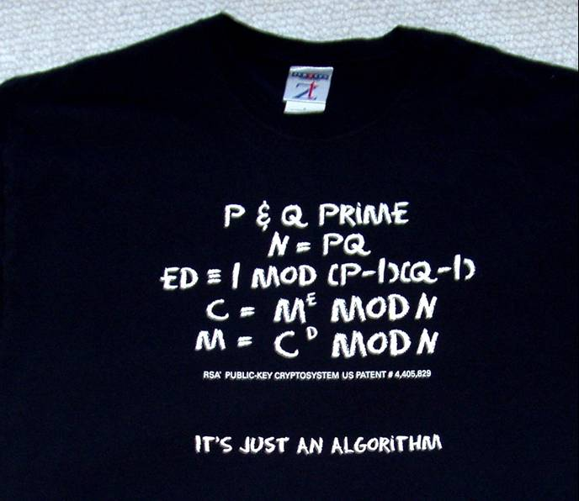
Factoring and RSA
Primality. Given an n-bit integer, is it prime?
Factoring. Given an n-bit integer, find its prime factorization.
Significance. Efficient primality testing ⇒ can implement RSA.
Significance. Efficient factoring ⇒ can break RSA.
Theorem. [AKS 2002] Poly-time algorithm for primality testing.

Slide 60
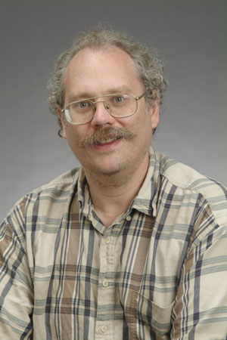
Shor's Algorithm
Shor's algorithm. Can factor an n-bit integer in O(n³) time on a quantum computer.
Ramification. At least one of the following is wrong:
  RSA is secure.
  Textbook quantum mechanics.
  Extending Church-Turing thesis.
algorithm uses quantum QFT !
Notes:
QFT = quantum fourier transform

Slide 61
Shor's Factoring Algorithm
Period finding.
Theorem. [Euler] Let p and q be prime, and let N = p q. Then, the following sequence repeats with a period divisible by (p-1) (q-1):
Consequence. If we can learn something about the period of the sequence, we can learn something about the divisors of (p-1) (q-1).
2 ^{i}
1
2
4
8
16
32
64
128
…
2 ^{i} mod 15
1
2
4
8
1
2
4
8
…
period = 4
2 ^{i} mod 21
1
2
4
8
16
11
1
2
…
period = 6
x mod N, x² mod N, x³ mod N, x⁴ mod N, …
by using random values of x, we get the divisors of (p-1) (q-1),
and from this, can get the divisors of N = p q
Notes:
http://scottaaronson.com/blog/?p=208
Note: period can be as large as N -> not helpful for efficient classical factoring algorithm

Slide 62
Extra Slides

Slide 63
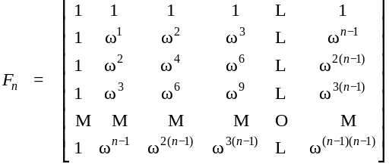
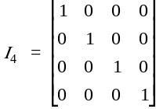
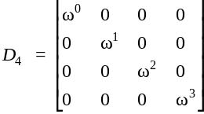
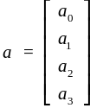

Fourier Matrix Decomposition

